Slide 1
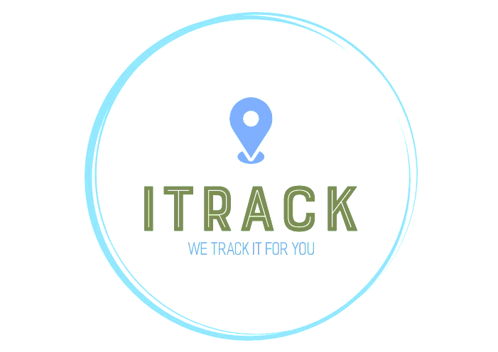


I-Track
We Track it for You
Team :
Salaheddine EL BAIDOURY
Abdelhadi ESSABRI
Mohamed SAIDI
Abdelali JADELMOULA
Chaimaa EL KABBACH
Ikram BEL ARMIA

Slide 2
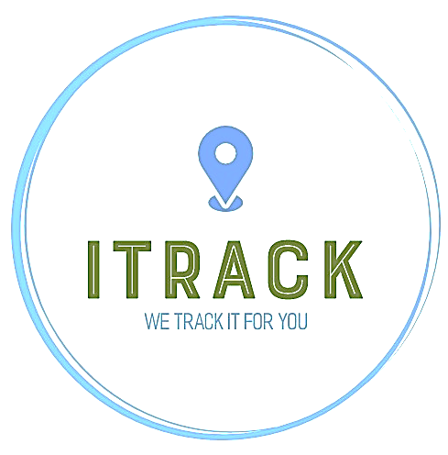







OVERVIEW ABOUT I-TRACK
I-Track is a part of the IT/ Technology Services, was established in 2021.
One such path breaking technology is tracking based on GPS.
We at, ITrack, have used this technology for providing innovative services.
WHO ARE
WE :
We, at I-Track, are fully dedicated to ensure the best tracking services for all our clients. We provide services related to tracking available in four domains :
WHAT WE
DO :
Personal Tracking
Vehicle Tracking
Pets Tracking
Mobile Tracking

Slide 3
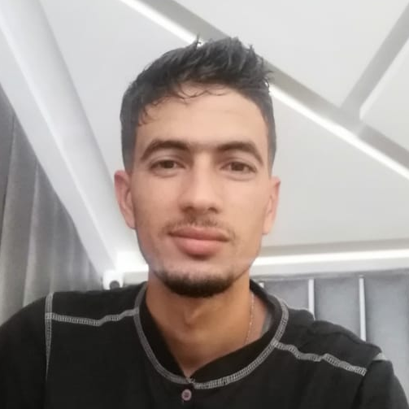

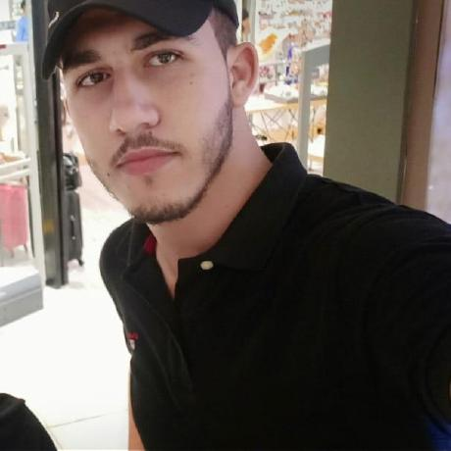
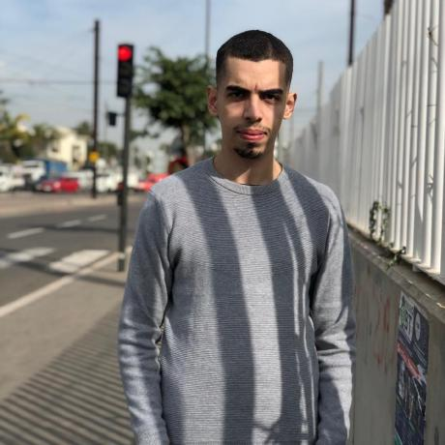
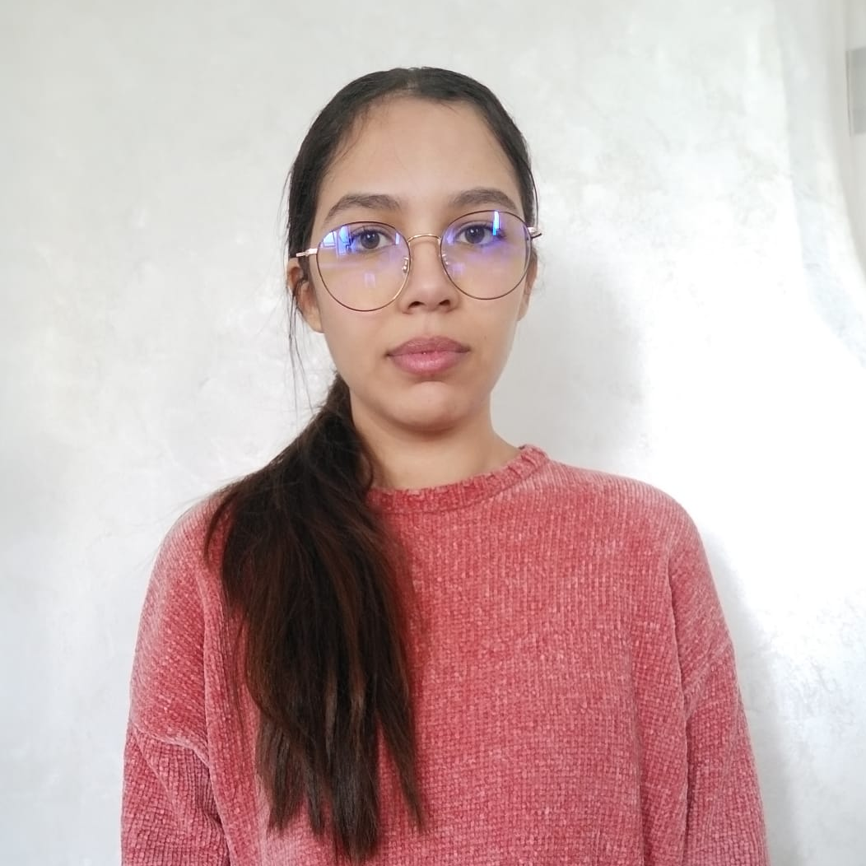
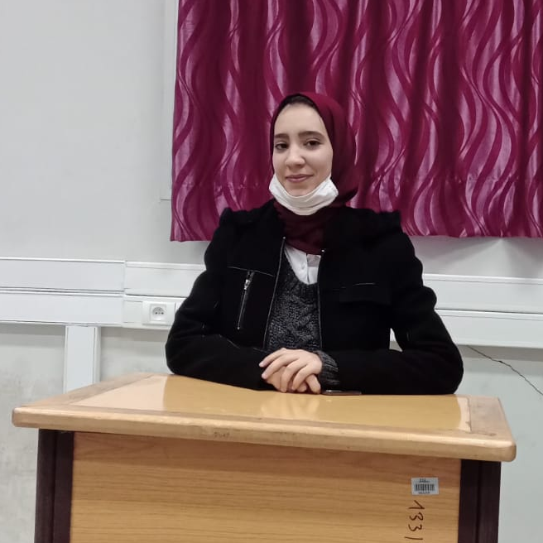
OUR MEMBERS :
THE EXECUTIVE TEAM MEMBERS
Abdelhadi ESSABRI
Salaheddine EL BAIDOURY
Abdelali JADELMOULA
Data Scientist
Project Manager
IT Architect
Cloud Engineer
DevOps Developer
Mohamed SAIDI
Chaimaa EL KABBACH
Ikram BEL ARMIA
BI Engineer
Designer
Data Analyst
Data Engineer

Slide 4
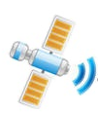



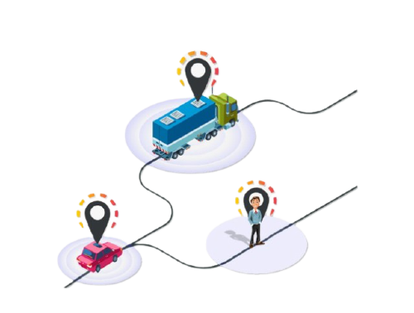
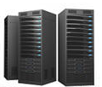
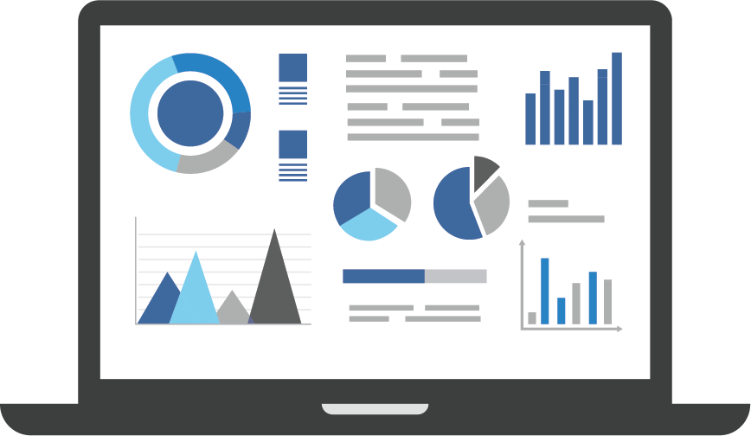


OUR FIRST PROJECT : Real time Data Streaming Analytics System for Tracking Pedestrians.
Data Transmitted to a dedicated Server
Handle & Analyse the data
Provide Real Time Dashboard
. . .
The Tracking will be done using TRACCAR client application

Slide 5
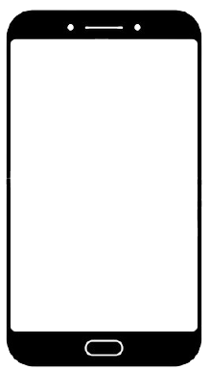
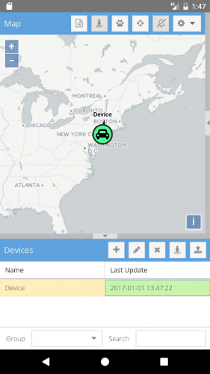
TRACCAR APPLICATION :
Traccar Client is an application that allows you to use your mobile device as a GPS tracker. It reports location to your own or hosted server with selected time intervals.

Slide 6
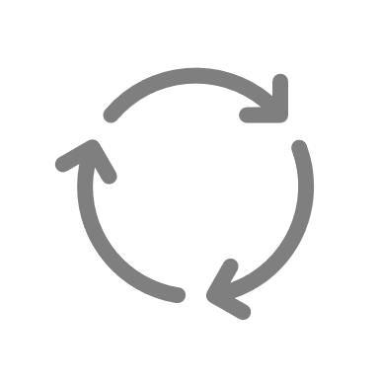

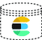

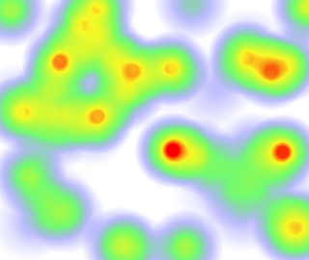
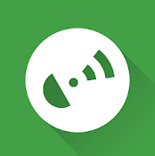
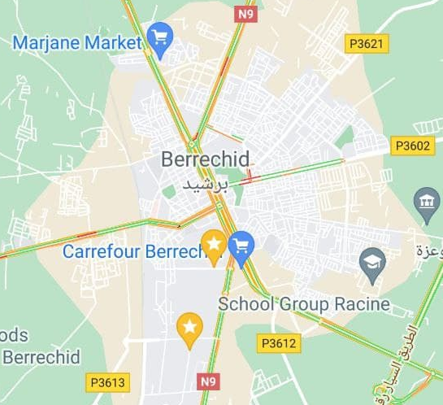


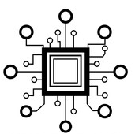
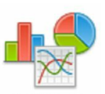
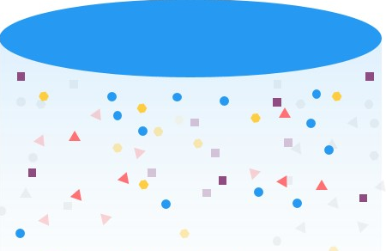
The main Functional architecture of the project ;
Project Architecture :
Data Source
Streams Processing
Data Reporting
Handle generated data in real time
Data Ingestion (Broker)
Serving Data
Data Processed
Data Server recipient
ETL Process
Heatmap
Advanced Computing
GPX Data Format
Advanced Analytics Algorithm
Data Lake – Long Term data Storage
Traccar application’s users
Persist Raw Data
ML Algorithm calculation
Dashboard, Reports

Slide 7



Progress Level of the project ;
Current Step :
Bind the application to the server
Traccar Client Application
Custom Server

